Slide 1


Mitchell’s Big LEAP
Enterprise Transformation
Ryan North
June 04, 2013

Slide 2
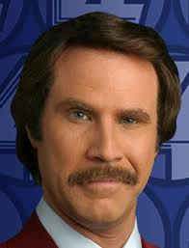
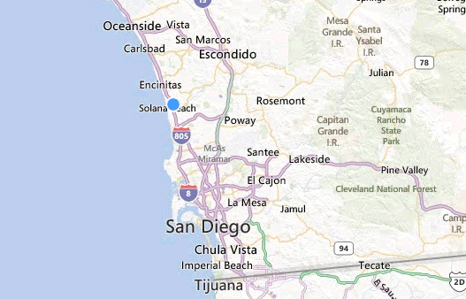

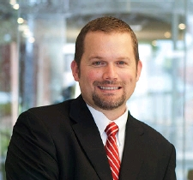
A bit about me
Dispatch
A bit about me
Personal
San Diego Born & Raised
Married
3 Kids
1 Dog
1 Cat
Plays the Ukulele
Owns a 1927 Ford Model T
Runs, Bikes & Swims
Loves the Pacific Ocean
https://twitter.com/northworx
“Mmm. San Diego. Drink it in, it always goes down smooth.”
Career
DEV & OPS (16 Years)
M.S. Software Engineering
B.S. Computer Science

Slide 3
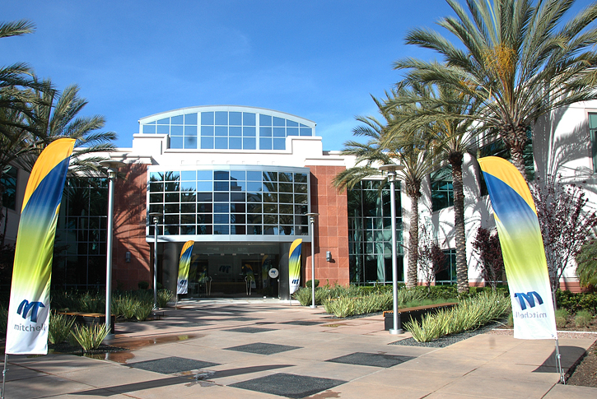
Mitchell Corporate Overview
Dispatch
Founded:
1946
Corporate HQ:
San Diego, California
Total Employees:
~1,800 and growing
Three Business Units:
Auto Physical Damage Auto Casualty Solutions Workers’ Compensation
Principal Shareholders:
Aurora Capital Group
GE Pension Trust
Notes:
3

Slide 4

Mitchell Solutions
Auto Physical Damage
Workers’ Comp Solutions
Auto Casualty Solutions
Intelligent Payment Solutions
Over $200M investment to date
State-of-the-art primary and secondary data centers
Industry leading up-time
and performance
Easy-to-implement
integration options
Benefits include common
functions and platform reporting
Global Markets
Notes:
4

Slide 5
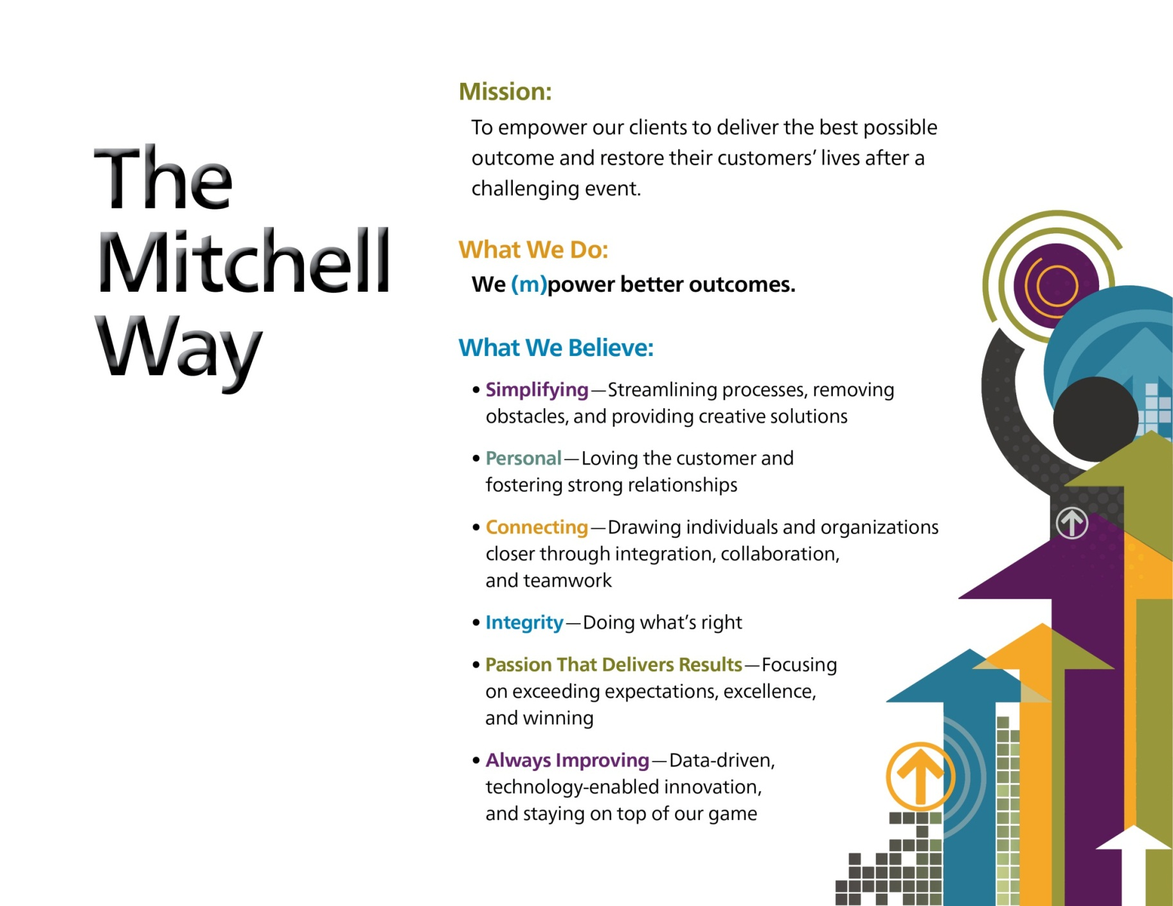
The Mitchell Way
Dispatch
Notes:
5
A reminder of who we are, what we do and what we believe in with the aim to align values and actions (evidence of values) to drive better business outcomes.

Slide 6

We made a BIG LEAP
Dispatch
We made a BIG LEAP
Our Enterprise LEan|Agile Program
Notes:
We didn’t know what to call this thing so we held a naming contest and the winning entry was LEAP for Lean|Agile Program.

Slide 7
Dispatch
"If you give a change a name, you immediately will create resistance to it in your organization.“
~ Avery, Christopher

Slide 8
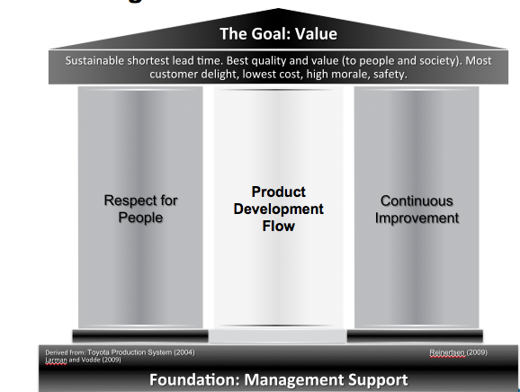
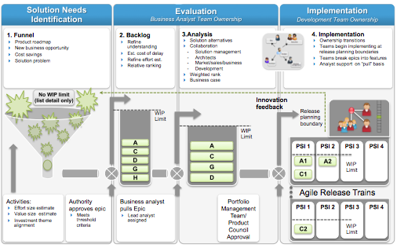
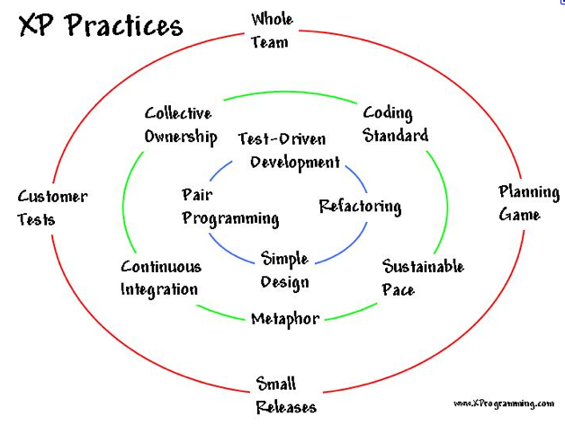
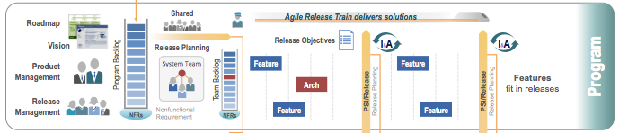
Our Lean|Agile Journey
Dispatch
Our Lean|Agile Journey
Agile teams
Agile Programs
Agile Technical Practices
Agile Portfolio Management &
Agile Architecture
Lean Thinking Enterprise
Notes:
A vision of where we wanted to be and how we saw ourselves getting there

Slide 9

We established a mission
Dispatch
Our (M)ission
Empower teams to delight our clients,
through early and continuous delivery,
of the most valuable and highest quality software, quickly and sustainably,
within a principled delivery framework,
founded upon The Mitchell Way.

Slide 10
Expected Benefits
Dispatch
Some expected benefits
Business Results
Productivity
Engagement
Time to Market
Quality
makes the work more enjoyable, helps us work together, and is empowering
− Medtronic
Agile teams average 37-50% faster to market
− QSM research
Our agile teams introduced 50% less defects into production
− confidential
We experienced a 20-50% increase in productivity.
− BMC Case Study
Notes:
Business results matter

Slide 11
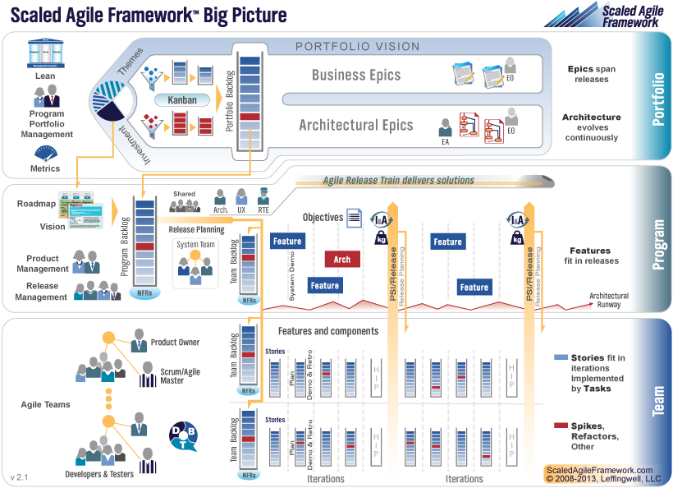
The Big Picture
Dispatch
There is just something about a picture

Slide 12
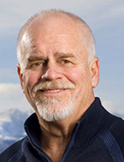
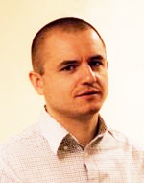
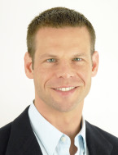
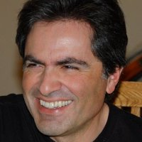
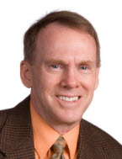
Dean Leffingwell and Team
Dispatch
We made a few friends

Slide 13



Our Lean|Agile Rollout
Dispatch
We did a few things…
2012 Enterprise Lean|Agile Program Rollout
JAN
FEB
MAR
APR
MAY
JUN
JUL
AUG
SEP
OCT
NOV
DEC
APD Repair Solutions Train
ACS Train
WCS Train(s)
In 2011
Leadership,
Kanban,
Scrum Master
Training
APD Claim Solutions Train
APD A&P Train
Product
Owner
Leadership
Workshop
Leadership
Workshop
Agile
Architecture
TDD
Hackathon
ART QS
Training
PSI Review followed by Planning for next PSI
Activity Already Completed

Slide 14
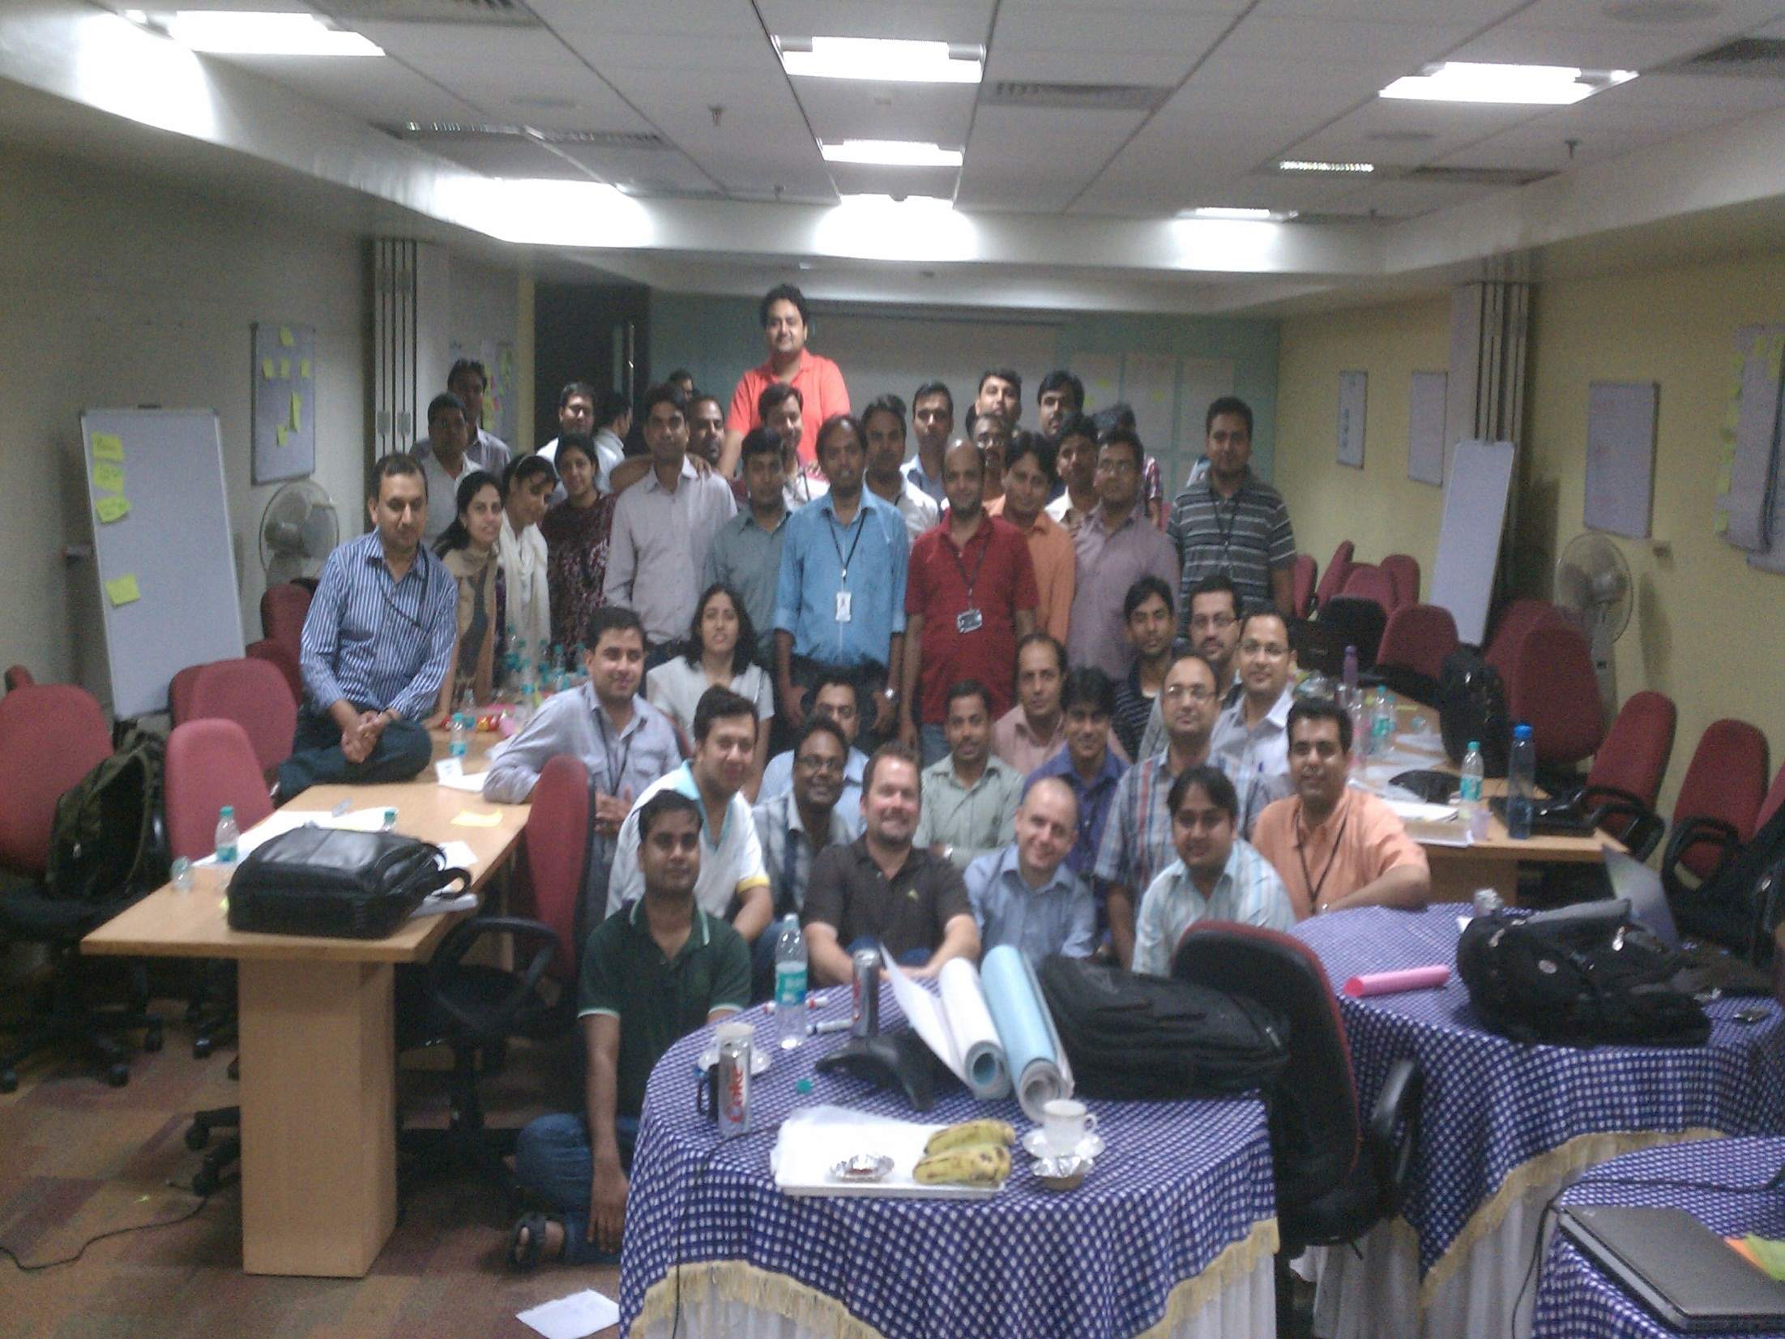

Slide 15

Where are we today?
Dispatch
To date we have….
Where are we now?

Slide 16
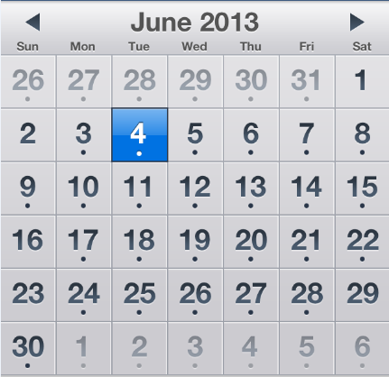
Some stats
Dispatch
To date we have….
Launched 5 Agile Release Trains
Formed ~60+ D/B/T Scrum Teams
Completed ~21 PSIs
Completed ~99 sprints

Slide 17
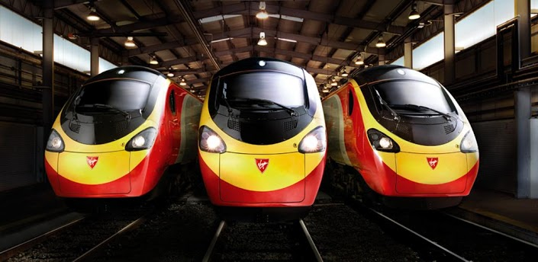
The Trains Keep Rolling
Dispatch
And the trains keep rolling…

Slide 18
Our Lean|Agile Journey
Dispatch
Our Lean|Agile Journey
Agile teams
Agile Programs
Agile Technical Practices
Agile Portfolio Management &
Agile Architecture
Lean Thinking Enterprise
Notes:
We are not done

Slide 19
The Lean Thinking Enterprise
The Goal: Value
Sustainable shortest lead time. Best quality and value (to people and society). Most customer delight, lowest cost, high morale, safety.
Dispatch
Lean Thinking Enterprise (where we want to be)
Respect for People
Product Development Flow
Continuous Improvement
Foundation: Management Support
Derived from: Toyota Production System (2004)
Larman and Vodde (2009)
Reinertsen (2009)
Notes:
This is where we want to be as part of our overall commitment to our cultural beliefs and brand attributes

Slide 20

Our Problem
Dispatch
We are creating an environment where
engaged people thrive;
employ boundary-less thinking;
work together in teams;
solve the world’s problems;
have fun
and win.
This means going beyond
our technology community

Slide 21

We can do it!
Dispatch

Slide 22

Interdependencies (1)
Dispatch
Watch out for interdependencies
Notes:
interconnections and interdependencies make it difficult to change anything without changing everything
In fast-moving environments these interconnections and interdependencies increase
The stand-up exercise
Example: Releasing software in a SaaS environment

Slide 23
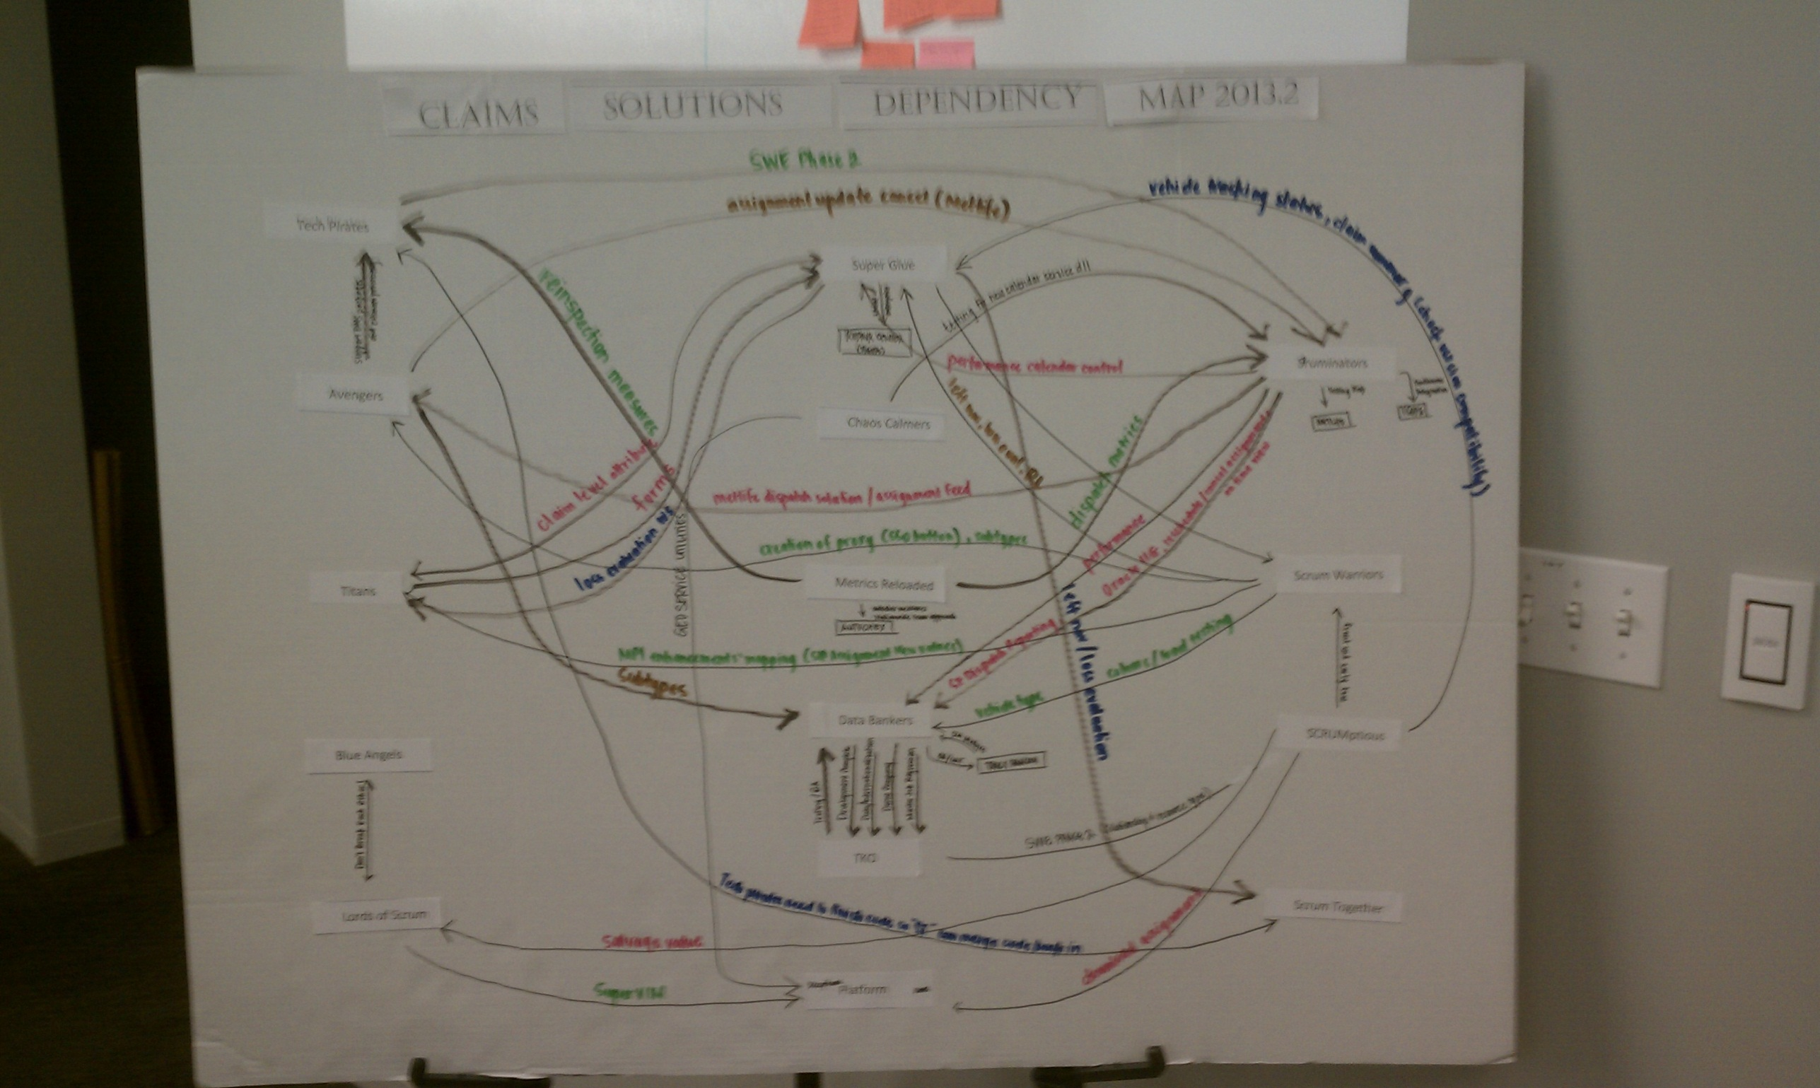
Interdependencies (2)
Dispatch
Remove the unnecessary ones
Notes:
The ACS team composition example
The build master and the SCM team

Slide 24
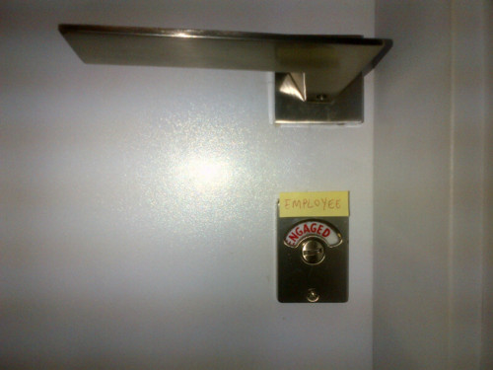
Take a pulse check once in a while
Dispatch
Take a pulse check (engagement surveys)
Try: http://www.perceptyx.com/
Notes:
Annual Engagement Surveys, Reviews and Action Planning

Slide 25
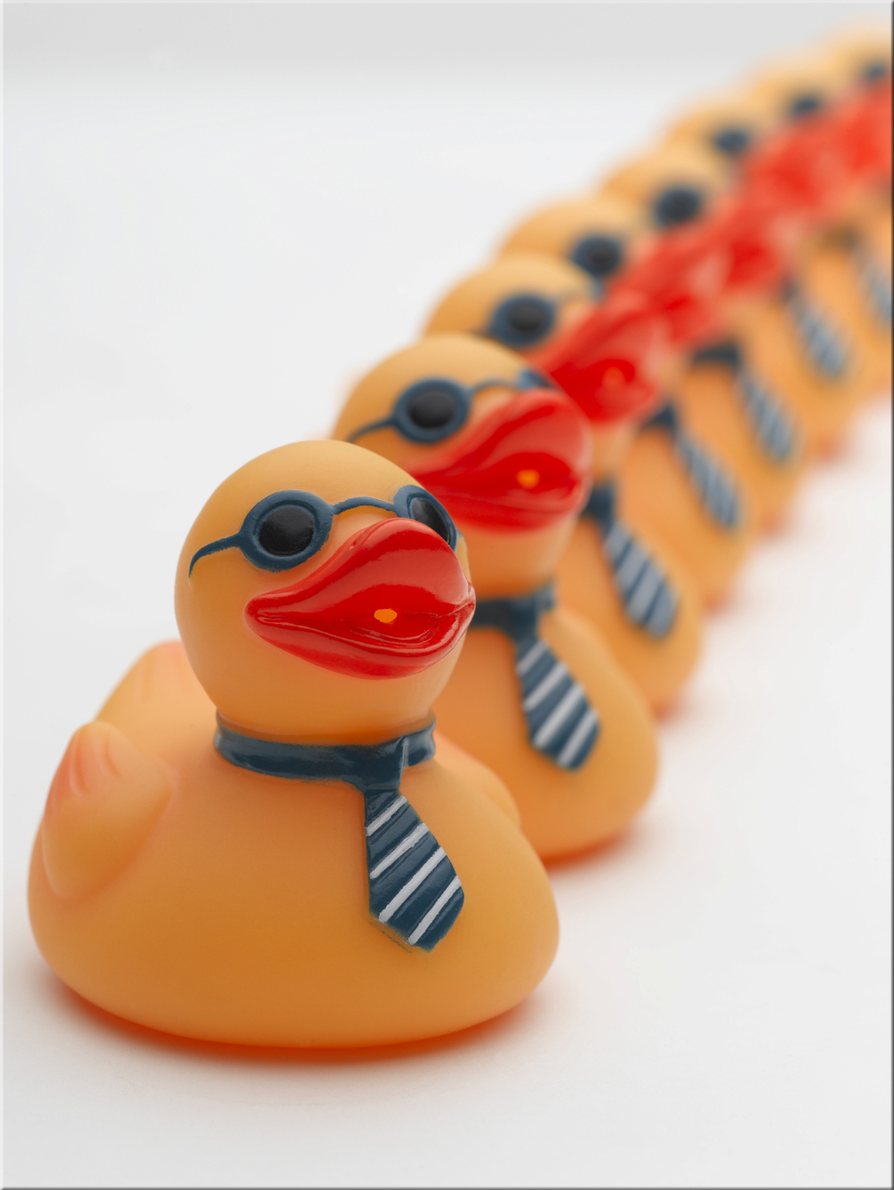
Align Everyone
Dispatch
Align Everyone
Notes:
A few of our alignment opportunities:
Strategic Planning (Session M) and Interlock (Interdependencies) Sessions
Portfolio Planning
Potentially Shippable Increment Planning
Sprint Planning
Performance and Career Development Planning
Performance Appraisals
1:1 Sessions
DEVCON
Leadership Sessions
National Sales & Service
Mitchell Way Day
Product and Technology Road Mapping
Budgeting
Some notes on alignment:
From the top down and the bottom up
Work with what you have
Our CEO’s Top 5 Objectives for 2013 are:
Delight our Customers
Live the Mitchell Way Everyday through Cross-Functional Teaming through the Application of Lean and Agile Principles
Simplify how we do business
Win in the Market
Improve the Bottom Line
Tell everyone what you are doing and then do it and then tell everyone what you did

Slide 26

Leverage Your Leadership
Dispatch
Leverage Your Leadership
Notes:
http://blogs.hbr.org/cs/2013/05/reinventing_middle_management.html?utm_source=Socialflow&utm_medium=Tweet&utm_campaign=Socialflow
Nearly 68% of these large-scale change and innovative efforts failed.
Pay particular attention to your middle managers (MLM).
Aside from the role of the senior executives, the most important determinant of success was the role of MLMs
MLMs are uniquely positioned to influence those above and below them in the org chart
What do we need our leaders to do?
Remove the Demotivators - Ask people what gets in the way of their doing work they are proud of. Remove those obstacles to pride in work.
Focus on Improving the Processes – Leaders, and everyone in our company for that matter, need to become more aware of what systems and processes are, and how to study them, and improve them.
Focus on Customers - Something that provides a lot of gratification and satisfaction to people is to know that customers are excited about the products and services they are delivering. Bring awareness of customers into the organization on a daily basis.
Demonstrate our Culture (be the poster child) – Reinforce leadership’s commitment to better business results through alignment of behaviors with culture
If you had +11% of your workforce to work with how would you deploy them?
Leadership Sessions
Lean|Agile Introductions and Working sessions
Lean|Agile Leadership Workshops
Lean Thinking and Tools
The Triple-A Leadership Model:
Alignment - Align MLM values with goals of initiative and culture
Leading the Mitchell Way
Leadership Workshops
Authorship - Engage MLM to Author Plans to Support Change Initiatives and align individual contributors
Leading the Mitchell Way
In many cases this is where new initiatives are identified
Examples: The PLAN Team, Autonomy Time, (m)Community
Action – MLMs must be responsible for the success of the initiatives they author
If you engage them they will be one of your greatest assets in your journey. Ignore them at your own risk.
One Challenge: Developing our leadership just in time – often employees are asked to change before their leadership has demonstrated the their own change. Reinforce leadership’s commitment to the culture
Beware of leaders who do not demonstrate your culture and take action before there is irreparable harm

Slide 27

Autonomy
Dispatch
Give People Autonomy
Notes:
Autonomy over work, team, workspace
Autonomy is relative and not absolute
Some of our experiments:
D/B/T Scrum Teams
Hackathons
Idea Jams
(m)Power Athletes!
(m)Community
PLAN
Rewards & Recognition
Brand Innovation Leadership Team
Special assignment opportunities (volunteers to work on special projects outside of the work they are obligated to do)
Up Next: Autonomy as a Formal Program / Autonomy over Workspace

Slide 28

Promote and Hire for Culture
Dispatch
Choose your team members wisely
Notes:
Don’t hold a team hostage to a single member who is unwilling to collaborate or demonstrate your culture everyday. Friction is fine and healthy, watch out for unhealthy behaviors
Not everyone is cut out to be on a D/B/T Scrum team or any team that requires a high degree of collaboration and cooperation (at least not the teams that are to available to them at that time…nature versus nurture / environment versus the individual). Be wary of mindless dogma. If someone can be useful in a different capacity then demonstrate respect for people and take action.
Examples of leveraging people who were not cutting it in their current role: Staffing the system team, special projects et al
Leverage the natural cooperators and connectors those that seem to be the glue that binds
Be careful who you hire, fire, demote and promote and why
Give the teams and the people a choice
SHL Assessments
The Mitchell Way Essay

Slide 29

Team Dynamics Matter
Dispatch
If it’s broke, fix it
Notes:
Team Interventions
“5 Dysfunctions of a Team” based assessments
Allow time for the team to self-correct
Coach as needed
Intervene before too long
Signs of a solid team: in addition to the business results they generate: they take breaks, eat lunch and generally hang together

Slide 30



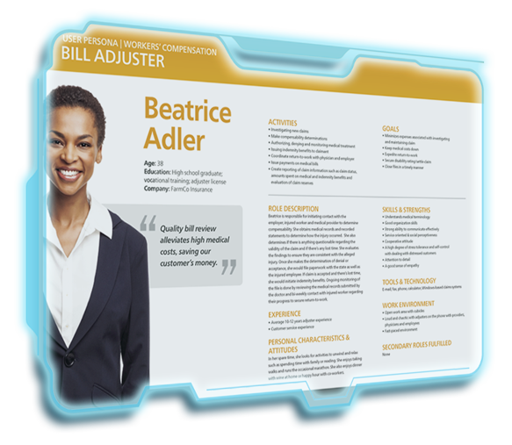


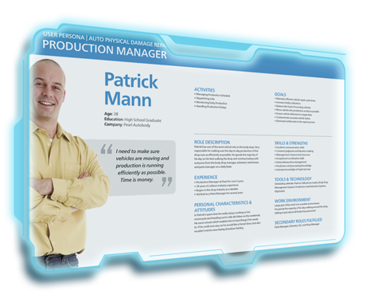
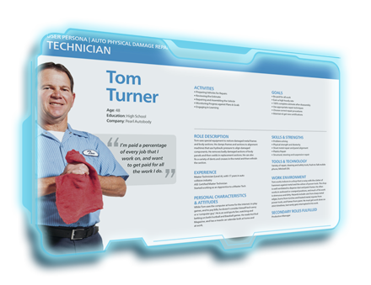
Know your customers (1)
Dispatch
Know your customers
How can you truly love and delight your customers if you don't know them?
Notes:
User Personas
Persona Proposal Program
Ride-A-Longs
NPS
Something that provides a lot of gratification and satisfaction to people is to know that customers are excited about the products and services they are delivering. Bring awareness of customers into the organization on a daily basis.

Slide 31
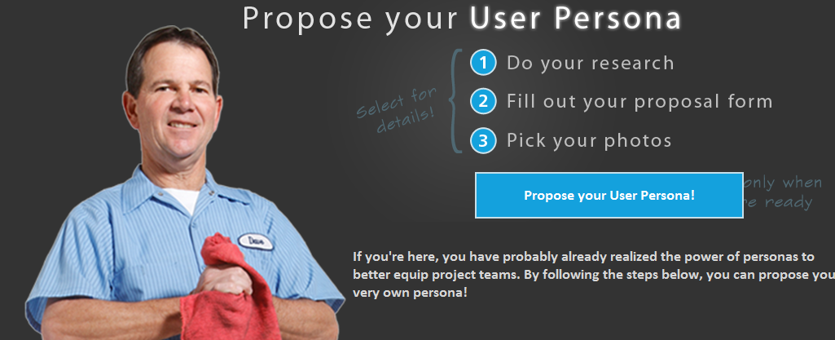
Know your customers (3)
Dispatch
Know your customers

Slide 32


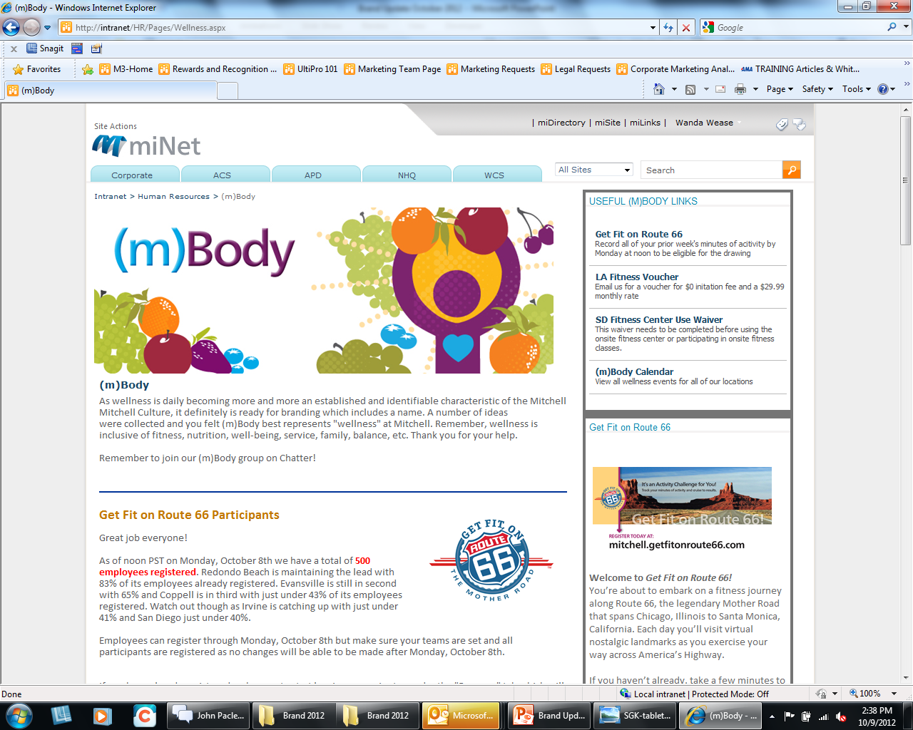
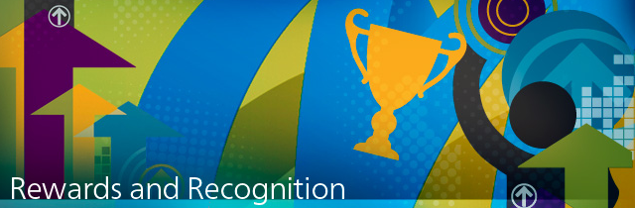
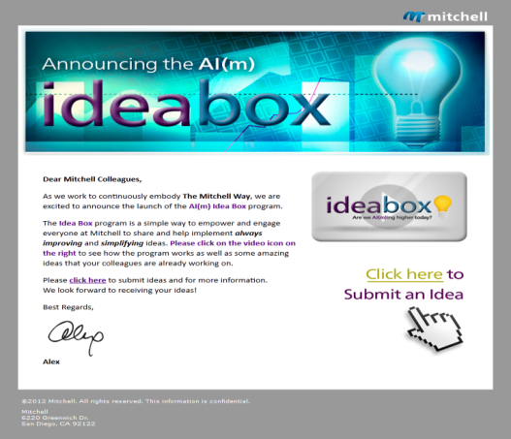
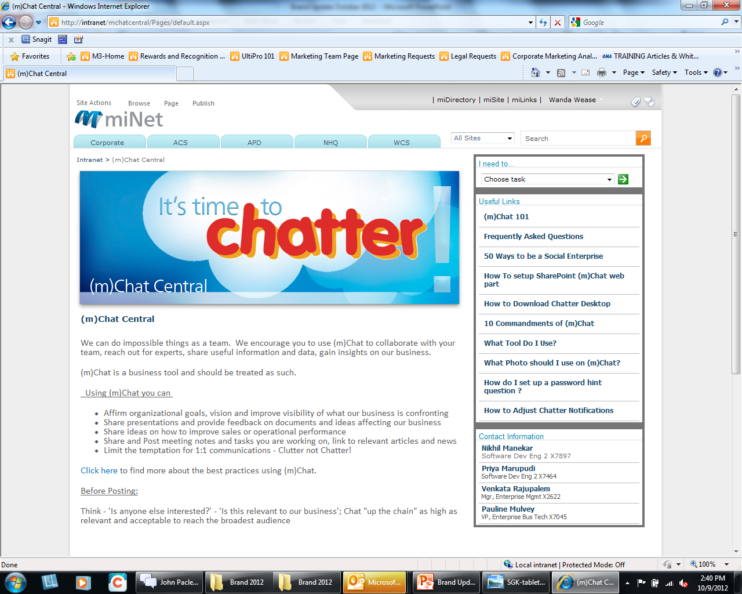
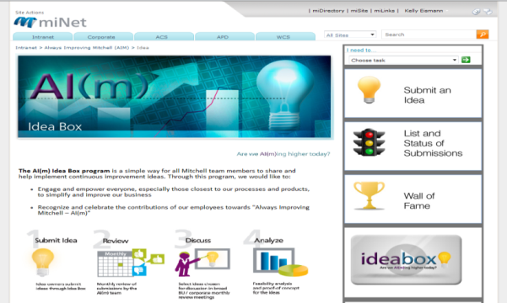
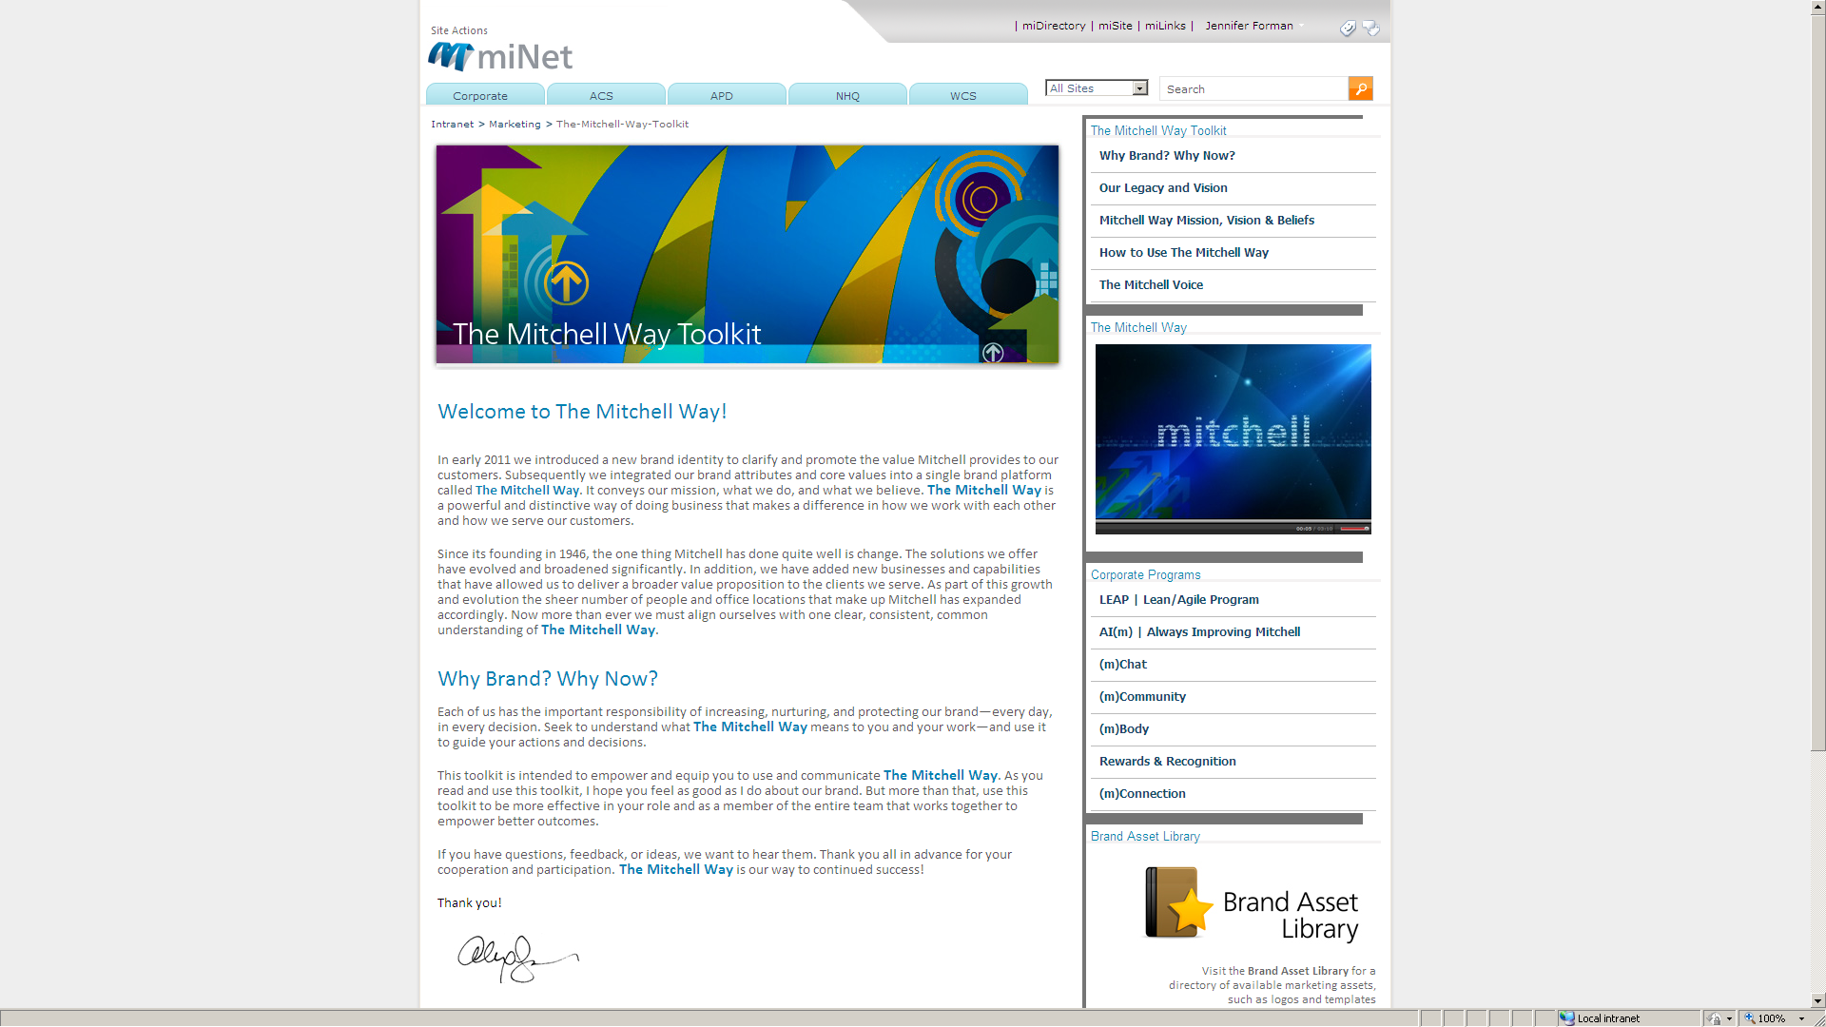
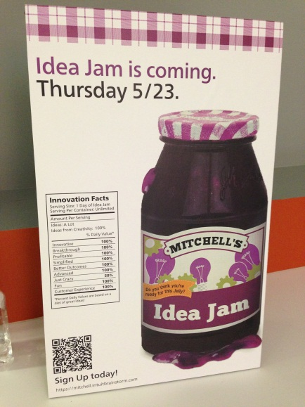

Create Shared Experiences (1)
Dispatch
Connect people through shared experiences
Communities of Practice
(m)Power Athletes!
Hackathon

Slide 33

Celebrate
Dispatch
Celebrate
Notes:
Demo Days (end of each PSI)
DEVCON
Innovation Fridays
Hackathons
Idea Jams
R&R Programs (Caveat)
Mitchell Way Days

Slide 34
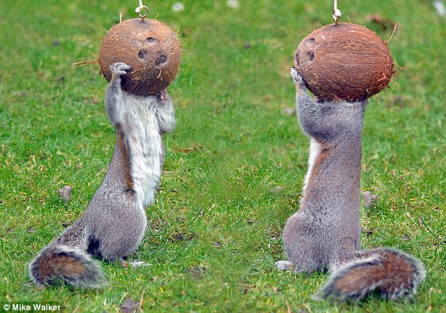
Find some nuts
Dispatch
Find some nuts
(or grow a pair…) @chadholdorf #thankyouchad
Notes:
Find people who are willing to stand up and make a difference

Slide 35

So…
How are we doing?

Slide 36
Only the Sith deals in absolutes
Dispatch
“Only a Sith deals in absolutes.” ~ Kenobi, Obi-Wan

Slide 37
A few bright spots
Dispatch
A few bright spots…
Business Results
Productivity
Engagement
Time to Market
Quality
Greatest thing Mitchell has done in the 14+ years I've been employed here!
− A Mitchell Employee
New Agile development process helps – they are making changes, testing & communicating with us.
− A Mitchell Customer
We have seen a reduction in post release field reported defects of 44%.
− A Mitchell Case Study
We realized a decrease in the time to deliver on a customer request of ~76%
− A Mitchell Case Study

Slide 38
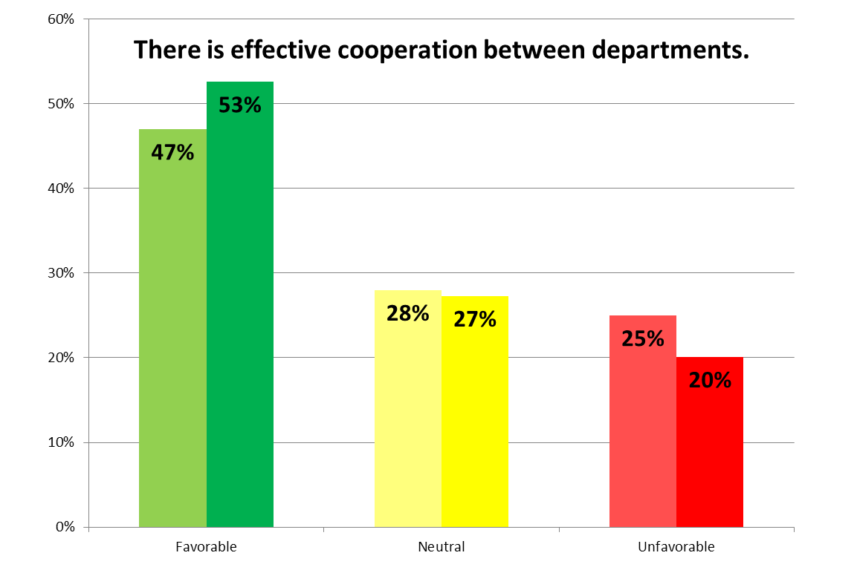
The results 1 year later
Dispatch
1-Yr later, we are improving

Slide 39
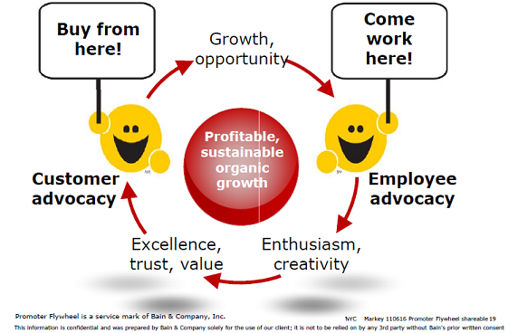
Only the Sith deals in absolutes
Dispatch

Slide 40

Only the Sith deals in absolutes
Dispatch
NPS +15%

Slide 41
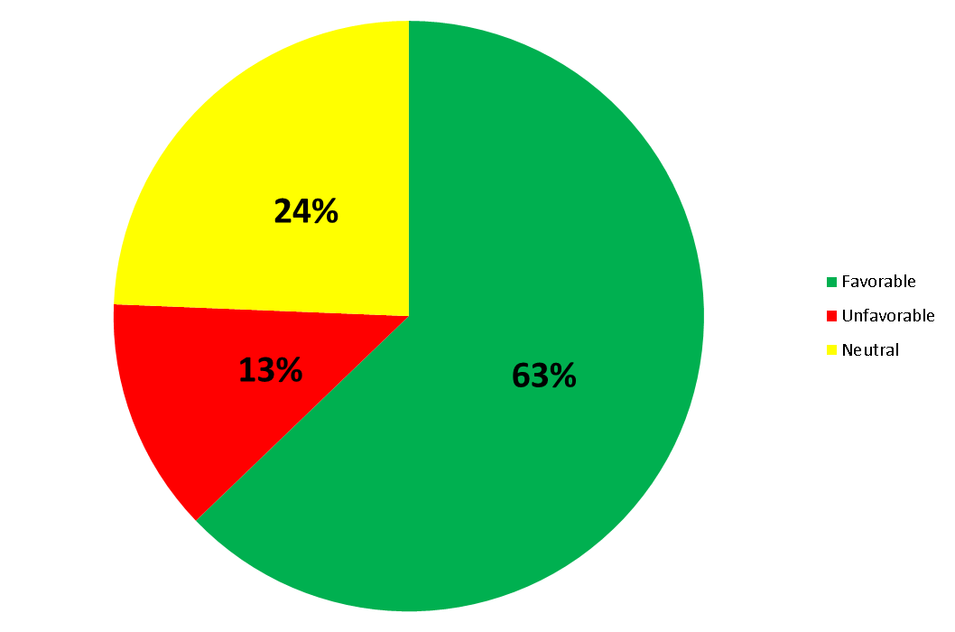
Response to Lean|Agile
Dispatch
Response to our Lean|Agile Journey

Slide 42

What’s Next?
Dispatch
What’s next?
Lean|Agile for Everyone
Living Our Way Everyday
Performance Management
Rewards & Recognition
DEVOPS
Women in Technology & Leadership
Organizational Design

Slide 43
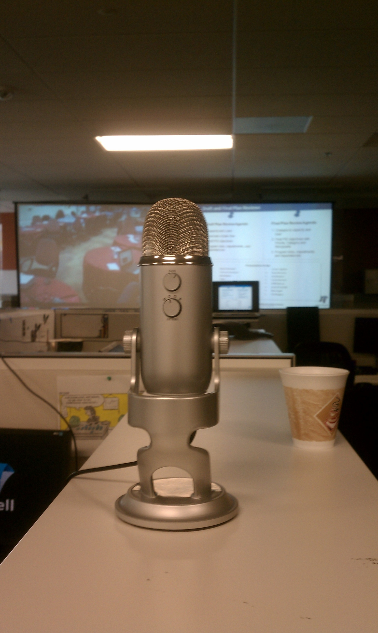
An Open Invitation
Dispatch
An Open Invitation
Come and See!
Join us in San Diego for one of our PSI events.

Slide 44
About Us
Dispatch
A bit more about us…
YouTube
  http://www.youtube.com/user/MitchellIntl
WWW
  http://www.mitchell.com

Slide 45

We are Hiring
Dispatch
We are looking for a few good people.
ryan.north@mitchell.com
951.440.6308
http://www.mitchell.com/careers/

Slide 46

Thank you
Dispatch
Thank you!

